Slide 1
ROBOTIC SURGERY
BY:
MUHAMMAD SHAHBAKHT KHURRAM(L22-6654)
SYEDA ARSHAH LAMEES(l22-6979)

Slide 2
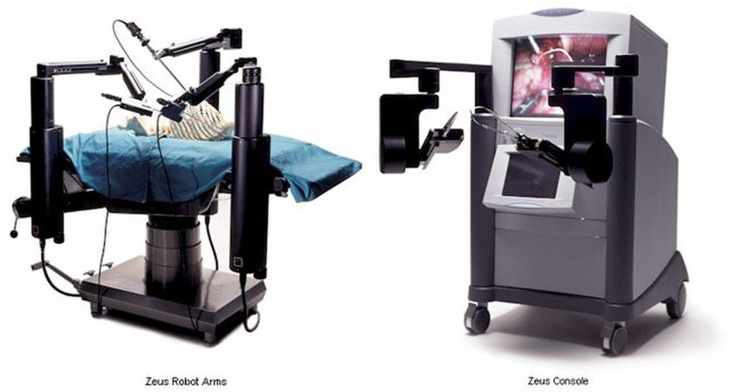
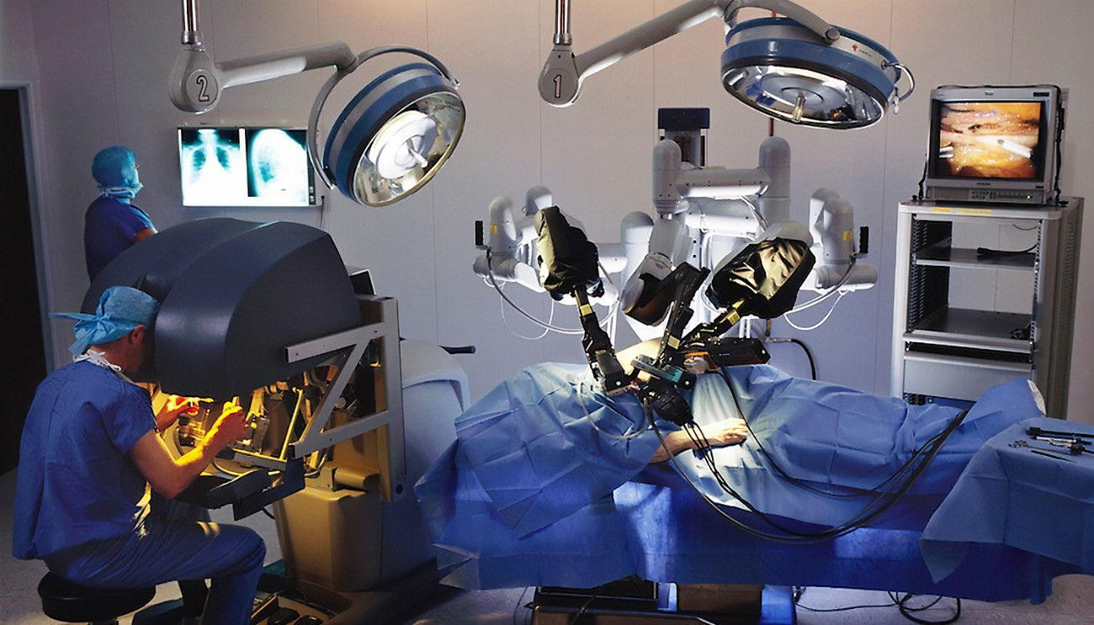
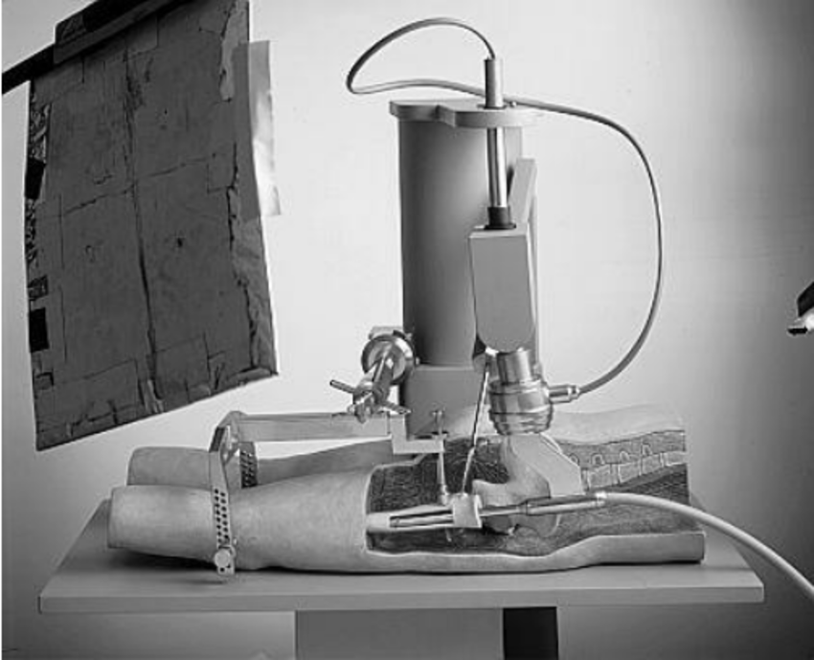
INTRODUCTION:
Robotic surgery are done by using robotic arm.
developed to overcome the limitations of pre-existing minimally-invasive surgical procedures.
allows doctors to perform many types of complex procedures with more precision, flexibility and control.

Slide 3
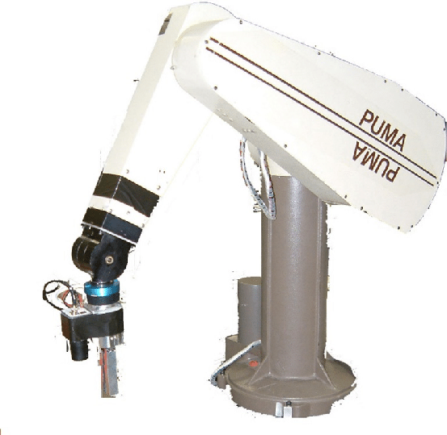
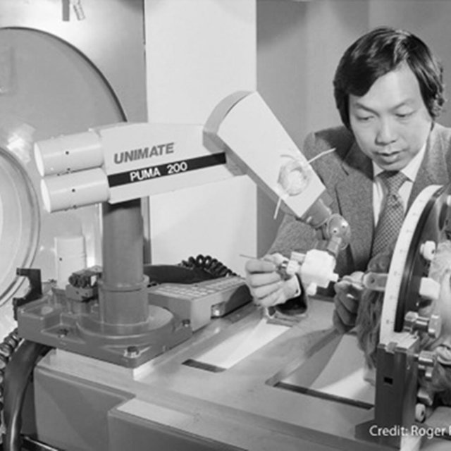
HISTORY:
NASA first sponsored a project to study robotic-assisted surgery for astronauts and soldiers who can’t get to human surgeons.
This first innovative robot was called the PUMA 200 and it was made by Westinghouse Electric.

Slide 4
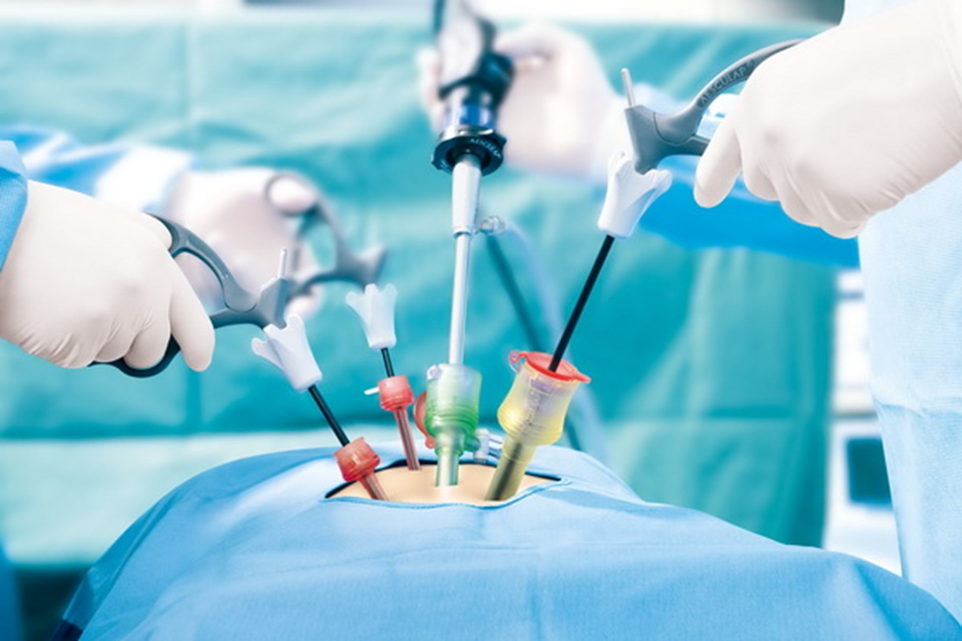
ORIGIN OF ROBOTIC SURGERY
LAPROSCOPY:
Laparoscopy, also known as diagnostic laparoscopy, is a surgical diagnostic procedure used to examine the organs inside the abdomen. It’s a low-risk, minimally invasive procedure that requires only small incisions.

Slide 5
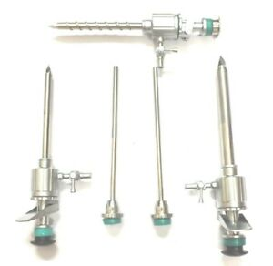
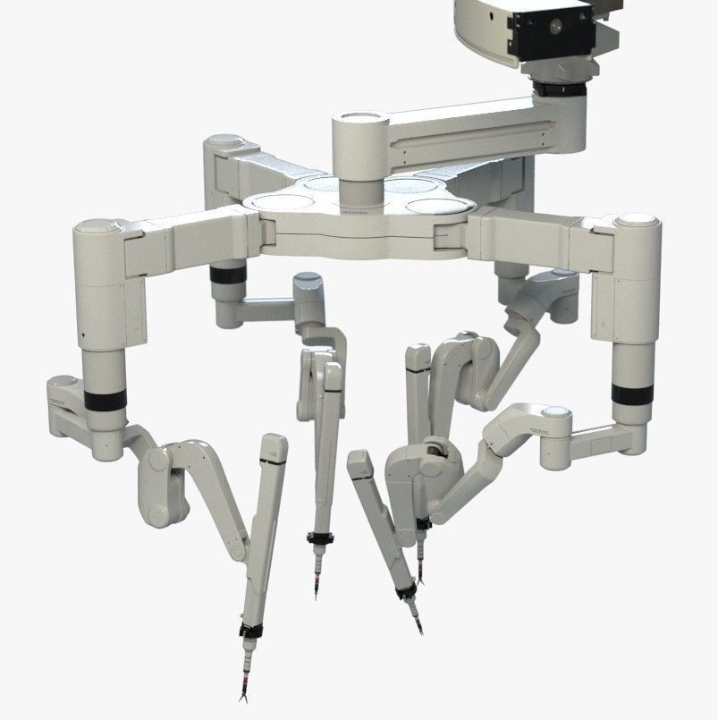
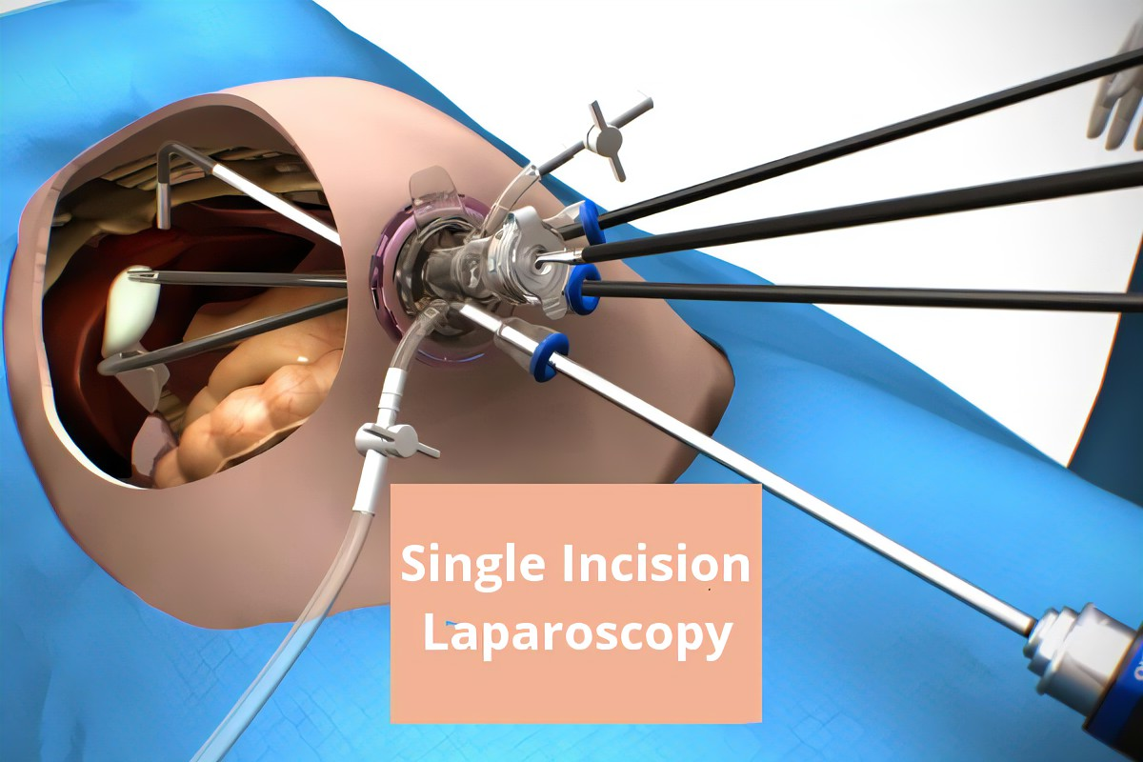
Why robotic surgery?
Robotic surgery has greater control of instruments than conventional laparoscopy.
Mimicking the surgeon’s hand, instruments in robotic surgery can move in any direction.
Better control enables the surgeon to perform more precise movements with great speed.

Slide 6
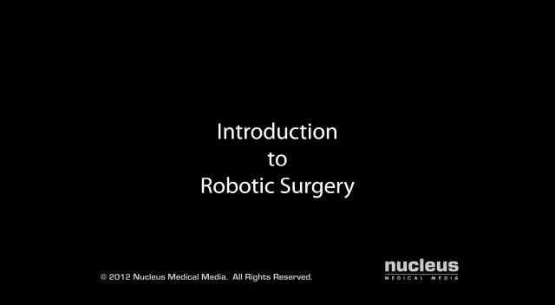
Working:
Surgeon looks into viewfinder to examine 3 D images that is projected by a camera inside the patient Under the viewfinder screen, the surgeon sees the instruments held by the arms and the surgical site Underneath the screen are the controls for the Endo wrist instrument Each time a joystick is moved, a computer sends an electrical signal to an instrument, and moves the robotic arm in sync with surgeon.

Slide 7
Types of robotic surgery:
AESOP robotic system
Da Vinci surgical Robotic System
Zeus Robotic Surgical System

Slide 8
AESOP robotic system:
Automated endoscopic system for optimal positioning
The camera moves based on voice commands given by the surgeon.
Aesop was cleared by food and drug administration in 1994 to assist the surgeons in minimally invasive surgeries .

Slide 9
Da Vinci surgical Robotic System:

Slide 10
Zeus Robotic Surgical System
The pictorial representation has been shown .

Slide 11
Advantages and disadvantages.
advantages
disadvantages
• Robotic surgery does not require as much incisions or cuts as does conventional surgery- Example-
• Conventional bypass surgery requires a 1 foot long incision along the patient's chest.
• Robotic surgery needs 3 or 4 incisions, each only about 1 cm in diameter.• Smaller incisions »› less pain and bleeding for the patient => faster recovery and less cosmetic distortions
The main disadvantage of robotic surgery is it is an expensive technology. Robotic surgery is not as accessible as conventional laparoscopic surgery due to availability and cost. Currently, most robotic surgery systems in Australia are installed in private hospitals. While many private health insurance companies cover the additional cost of robotic instrumentations, others do not cover this extra cost. However, cost is gradually coming down over time as the technology becomes more available and established. Other robotic surgery systems are also becoming available. Competition will hopefully bring cost down further, making robotic surgery more available and more accessible than before.

Slide 12
Working of robotic surgery in Pakistan.
The advancement of robotic surgery started in Pakistan in the year 2000 when FDA(food and drug administration)approved Da Vinci surgical system made by American company intuitive surgical.
in Pakistan first ever successful robotic surgical procedure was performed in 2019 . This took place in OT complex civil hospital Karachi and Sindh institute of urology and transplant(SIUT).
It was performed on 55 years old woman from Balochistan, who had intractable bleeding acquiring multiple transfusions. She underwent a surgical procedure called ‘hysterectomy’ through robotic surgery and her uterus was removed through it. The robotics surgery team consisted of Prof Shamim Khan from King’s College London and Dr Kankipati Shanti Raju from Guys and St Thomas Hospitals London. Both performed the successful surgery along with their staff.
the team says: “benefits — less pain, less loss of blood and a faster recovery as compared to traditional surgery — the greater use of robotic surgery was needed”.
this is a major breakthrough in the field of robotic surgery in Pakistan.
As Sindh Chief minister states that:
“the small spaces in the human body where the surgeon’s hands cant reach and that eyes can not see are easily approached by robotic arms”.

Slide 13
Cost of robotic surgery
A single robot costs about $2 million. Some of the attachments that go on the arms are disposable. And robotic surgery generally costs anywhere from $3,000 to $6,000 more than traditional laparoscopic surgery.

Slide 14

For the surgeons.
• Robotic surgery is much faster than conventional surgery as it decreases the fatigue that surgeons would experience during conventional surgery that would last for several hours and "Increases" the margin for error- Even the steadiest hands experience some tremor- Some of the approved systems have been programmed to compensate for tremor so robotic arm stays steady.
Hence robotic surgery aids the surgeon by providing:
Better Vision
Enhanced Dexterity

Slide 15
Success rate of robotic surgery
The published data regarding robot-assisted pyeloplasty show excellent results and success rates, ranging between 94% and 100%.
The rates of device malfunctions and failure-related conversions reported by these studies varied between 0.4–8.0% and 0.1–2.7%,

Slide 16
Scope of robotic surgery
Todays scope:
Robotic surgeries result in less blood loss. The minimally invasive robotic approach is slowly becoming the standard of care for many surgical procedures.
Immense valuable regarding deep pelvic surgery.
Extented use of medical robots .

Slide 17
Future of robotic surgery in pakistan
In Pakistan robotic surgery is majorly being used for urological operations.
Prof Dr Samia Malik, Head of Gynecology, said that up to 70 to 80% Gynecological surgeries could immediately be shifted to robotic surgery, while 20 to 30% surgeries may still have to be performed through prevalent methods.
Prof Mahmood Ayaz(Vc of KE) further said that robotic surgery is the future, saying that Robotic Surgery Database Registry would be set up; a Fellowship in Robotic Surgery would be launched with the collaboration of College of Physicians and Surgeons Pakistan (CPSP); and legislation would be moved to provide legal cover to patients.

Slide 18
Worldwide scope of robotic surgery.
Robotic surgery is being used most by USA in a percentage of41.7%
In india,with increases in demand, funding, and research, the robotic surgery market is projected to reach $14.4 billion by 2026.
In uk, There are now nearly 6000 da Vinci systems in operation that have performed 8.5 million procedures worldwide.⁶ The UK is home to approximately 115 of these, covering the majority of geographical regions.

Slide 19
Future of robotic surgery
Robots Are The Future – And The Future Is Now.
Robotic assisted surgery (RAS) has opened a new frontier of surgery, giving surgeons the ability to peer deeper into the human anatomy and reach areas of the body with a degree of precision beyond human capability.
Surgery robots are more and more finding their way into medical practice and their worldwide market is anticipated to increase steadily with a growth rate of 22% between 2018 and 2025. With a fast-aging population, and the increased shortage of healthcare professionals, together with important technological developments and innovations in the healthcare field, we are entitled to ask: will robots become the surgeons of the future? Surely.yes!
As , Vinod Khosla, a legendary Silicon Valley investor, also argues that robots will replace doctors by 2035. And there is some evidence that he may be right. ... While the robot took longer than a human, its sutures were much better—more precise and uniform with fewer chances for breakage, leakage, and infection.

Slide 20
conclusion
NOTE: these systems have been FDA approved for only a few select surgeries (mainly urology and gynecological)
All these systems show great promise- For example, the ZEUS system has already been used in Germany to perform minimally invasive coronary bypass surgery

